Slide 1
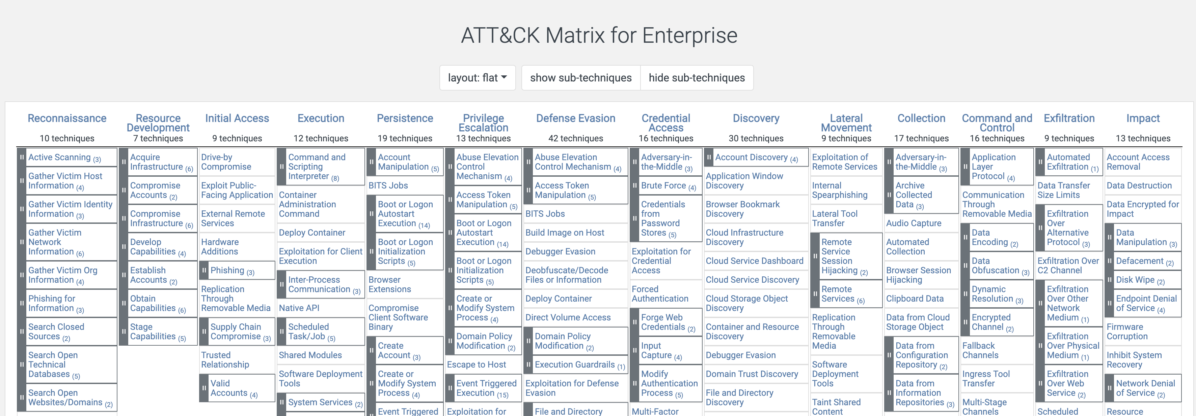
MITRE ATT&CK
https://attack.mitre.org/
Today we will be looking at privilege escalation.

Slide 2
Privilege Escalation

Slide 3


Escalating Privileges
Attackers have high, high hopes for their exploits.
The initial account a compromised user, service, or application is running under typically does not provide all of the capabilities an attacker needs to accomplish their goals (or even their next steps).
It is important to note that there is some overlap between:
Establishing Persistence and Escalating Privileges.
Escalating Privileges and Lateral Movement.
Sometimes a single step will escalate privileges and make an attacker persistent or will set them up to move laterally.

Slide 4

Examples of some Privilege Escalation techniques:
Specific CVEs for OS or installed software that allow for privilege escalation.
UAC bypass.
Elevating execution with a user prompt.
Token impersonation or theft.
Parent PID spoofing / injection.
Escape to host.
This Photo by Unknown Author is licensed under CC BY

